Slide 1
Data Update:
Yemen Baseline,
Afghanistan Trends
Part II of II
Center for Strategic and International Studies
April 4, 2011
Gary Langer
Langer Research Associates
glanger@langerresearch.com

Slide 2

Afghanistan surveys (ABC/media partners)
National, area-probability samples
Random selection, in-person interviews
Six in a series:
  Oct. 29-Nov. 13, 2010
  Dec. 11-23, 2009
  Dec. 30, 2008-Jan. 12, 2009
  Oct. 28-Nov. 7, 2007
  Oct. 14-19, 2006
  Oct. 8-18, 2005
Consistent methodology/reliable time trend

Slide 3
Latest:
Sponsors: ABC News/BBC/ARD/Washington Post
Field work: ACSOR, subsidiary of D3 Systems Inc.
Methodology: 227 random sampling points, stratified urban/rural, PPS to district, SRS at settlement level.
Provincial oversamples: Balkh, Bamiyan, Farah, Ghazni, Ghor, Helmand, Kandahar, Khost, Kunar, Kunduz, Nimroz, Nuristan, Paktia, Panjshir and Wardak.
Field: Area probability, random route, Kish grid. 209 Afghan interviewers, 98/111 m/f, 28% supervised or back-checked, logical controls in DP.

Slide 4
Specs., cont.
Noncoverage: 59 of country’s 398 districts were inaccessible for security reasons; 75 inaccessible to women interviewers. Noncoverage = 10% of men, 21% of women.
Replacements: 18 of 116 randomly drawn districts were inaccessible (15 security, 2 weather, 1 transportation); replaced by random draw.
Weighted to population of province and sex by region using CSO population projections.
Average 36-minute interview. Contact rate 86 percent, co-operation rate 94 percent, net RR 81 percent, MOE 3.5 points inc. DEFF of 2.2.

Slide 5
Field Work Hazard #1:
Security
Parwan (ACSOR photo)
(ACSOR photo)
Notes:
5

Slide 6
Baghlan …tankers were put to fire by Taliban, and one American armored vehicle was destroyed by Taliban rocket attack.
Faryab …One suicide attack took place in Khwaja Sabz Posh District which killed and injured lots of people
Ghor …The passengers including our interviewers were robbed of money by robbers on the road to one of Ghor districts.
Jawzjan…During our survey a fight between security police and Taliban took place, the fight continued for four hours.
Wardak …Taliban militants took with them a person on charges of being Arbaki and was sentenced to heavy castigation.
Nimroz …We witnessed rocket attacks on the second day of our work from Taliban on Nimroz airport.
Nuristan …Taliban insurgents blazed and set afire to a girls’ school in Mandool district and demolished the entire school building.

Slide 7
Field Work Hazard #2:
Getting Around
(ACSOR photo)
Notes:
7

Slide 8
Baghlan …the road in Salang was not in good condition, it was snowing and cars had crashed and fell down from the mountains… one car crashed with a big tanker in this accident all passengers in the small car were killed.
Jawzjan …While going to the province the car I was traveling in crashed with another car, in the accident the two men from opposite side were killed and two were badly injured.
Nuristan …landslide on the main highway had caused blockade of the way.
Kapisa …The flood destroyed the road to Nijrab district.
Wardak …On Sayed Abad highway in Dasht Toob area, a mini car made an accident with a giant vehicle where three people lost their lives.
Laghman …Armed insurgents are active in Alingar district where travel is an enormous issue.

Slide 9
Interviewer instruction: Note transportation issues (car trouble, car accidents, etc.)
Panjshir supervisor:
“1. Lack of mini buses.
“2. High prices of fuel, and road fares.
“3. Anarchy.”

Slide 10
Overview of Recent Trend
December 2009: Sharp improvements, public views buoyed by political, economic and military efforts.
  Election resolved peaceably, with promises/paybacks
  Improved delivery of development aid
  Promised U.S. surge/commitment
  Perceived Taliban setbacks
  Reduced USAF-attributed civilian casualties
November 2010: Retrenchment given unmet expectations. Favorable views of the U.S., ratings of its performance, confidence in its ability to provide security, support for its presence all match previous lows or set new ones.
  Where the surge has focused, views have improved (from low levels)
  Improvements there more than offset elsewhere, where instability or economic difficulties have grown and USAF presence is lacking
  Whack-a-mole: Taliban activity on the rise outside USAF focus areas

Slide 11
External validation
March 10, 2011: Kunduz police chief killed by suicide bomber “while he was walking on the street to show how secure Kunduz has become after recent military operations.” Several bodyguards seriously injured.
“Strong Taliban presence in this area,” Kunduz results:
  December 2009: 4%
  November 2010: 28%

Slide 12
Views of the U.S. Effort

Slide 16
Notes:
Some pushback… but.

Slide 23
Factors:
Violence, the Taliban and frustration with development

Slide 24
Notes:
does not account for frequency.

Slide 27
 | Support U.S. presence | Better life in a year
Taliban grown stronger | 58% | 58%
Taliban grown weaker | 67% | 76%
Taliban very active in area | 52% | 52%
Taliban not active in area | 69% | 70%
Coalition bombing in area | 49% | 59%
No bombing in area | 68% | 69%
Civilian casualties in the area | 53% | 61%
No civilian casualties | 68% | 68%
Violence in the area | 59% | 62%
No violence in the area | 71% | 73%

Slide 32
Regional/provincial differences

Slide 33
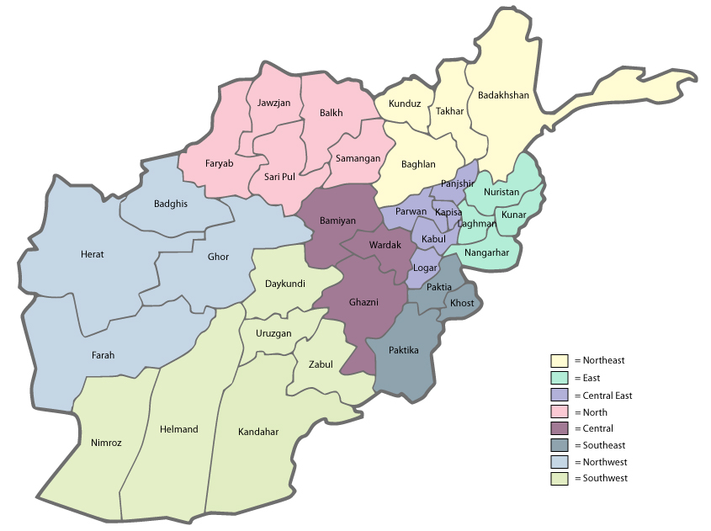
Regions of Afghanistan
ABC News/BBC/ARD/Washington Post poll

Slide 34
First the good news

Slide 35
Attitudes Towards the U.S. in Helmand
ABC News/BBC/ARD/Washington Post poll
+24 pts
+24 pts
+18 pts
+15 pts
+12 pts

Slide 36
The Taliban in Helmand
ABC News/BBC/ARD/Washington Post poll
-46 pts
-16 pts
-15 pts
-13 pts
-11 pts

Slide 37
Positive Ratings of Living Conditions in Helmand
ABC News/BBC/ARD/Washington Post poll
+53 pts
+45 pts
+45 pts
+35 pts
+27 pts
+24 pts

Slide 38
Attitudes Towards the U.S. in Kandahar
ABC News/BBC/ARD/Washington Post poll
+24 pts
+22 pts
+27 pts
+17 pts
+20 pts

Slide 39
The Taliban in Kandahar
ABC News/BBC/ARD/Washington Post poll
-17 pts
But...
+9 pts
+16 pts
+17 pts
+20 pts

Slide 40
Whack-a-mole
Taliban has been squeezed out of Helmand/Kandahar into other regions of the country.
  Increased reports of violence / Taliban activities
Development projects have slowed in areas outside of the focus of the surge.
  Decline in living conditions
  Deteriorating economic conditions

Slide 42
Notes:
documenting regional differences…

Slide 43
Notes:
documenting regional differences…

Slide 44
Living Conditions – Province/Region
(ACSOR photo)

Slide 46
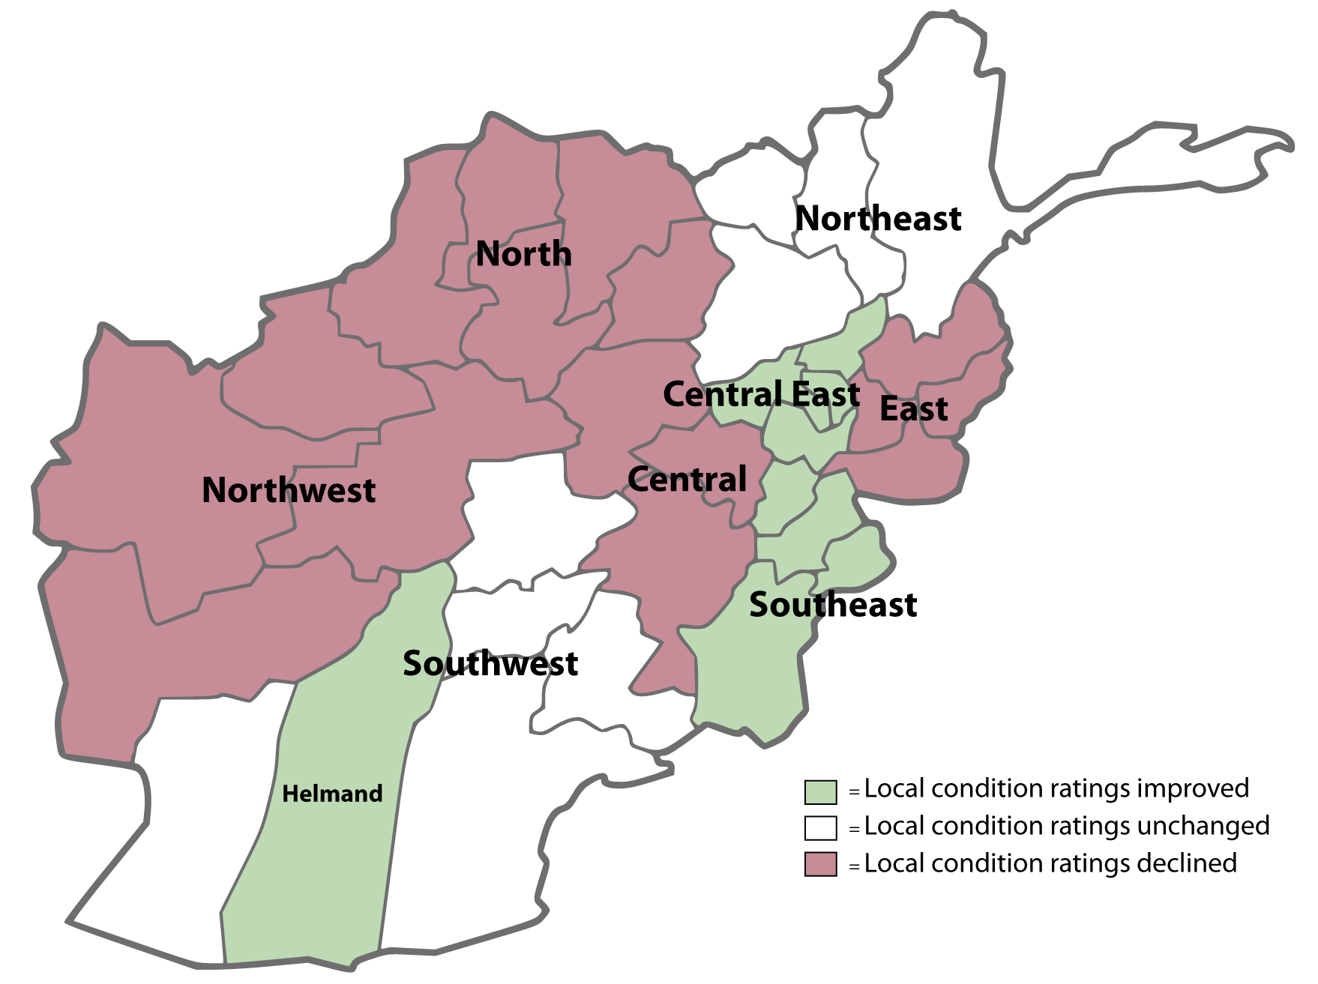
Region-Level Change
in Ratings of Local Conditions
Year-to-year change in average number
of positive ratings of local conditions
Note. Region Level Ns range from 60 to 511 (Helmand N = 200). All changes indicated are statistically significant at p < .05.

Slide 47
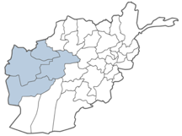
Biggest Drops in Positive Ratings of Local Conditions in Northwest Afghanistan
ABC News/BBC/ARD/Washington Post poll
-25 pts
-20 pts
-20 pts
-11 pts
-8 pts
-7 pts

Slide 48
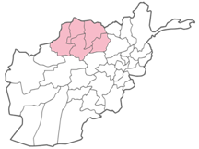
Biggest Drops in Positive Ratings of Local Conditions in North Afghanistan
ABC News/BBC/ARD/Washington Post poll
-27 pts
-24 pts
-24 pts
-23 pts
-14 pts
-12 pts

Slide 49
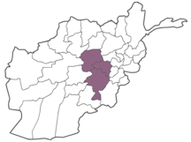
Biggest Drops in Positive Ratings of Local Conditions in Central Afghanistan
ABC News/BBC/ARD/Washington Post poll
-28 pts
-28 pts
-20 pts
-18 pts
-16 pts
-14 pts

Slide 50
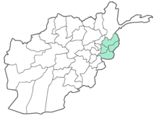
Biggest Drops in Positive Ratings of Local Conditions in East Afghanistan
ABC News/BBC/ARD/Washington Post poll
-31 pts
-30 pts
-18 pts
-18 pts
-15 pts
-14 pts

Slide 51
Predicting support for U.S. presence
R² = .279
Significant predictors:
  Blame U.S./NATO for civilian casualties (-)
  Blame Taliban for violence (+)
  Civilian deaths in the area (-)
  Optimism that life will be better in a year (+)
  Ethnicity: Pashtun (-)
  Local conditions (+)
  Foreign aid (+)
  Development efforts (+)

Slide 52
Governance and ways forward

Slide 62
Thank you!
Data Update:
Yemen Baseline,
Afghanistan Trends
Center for Strategic and International Studies
April 4, 2011
Gary Langer
Langer Research Associates
glanger@langerresearch.com

