Slide 1
Transparency in Opinion Polling
Gallup International Association • Sept. 23, 2025
Gary Langer
Langer Research Associates
glanger@langerresearch.com

Slide 2
My background - and the problem
10 years as an AP reporter
30+ years covering the beat of public opinion for ABC News
I know the drill:
Numbers and percentage signs lend credibility to anecdote
Reporters are both data hungry and math phobic
Too often, polling = P.R. – for all involved

Slide 3
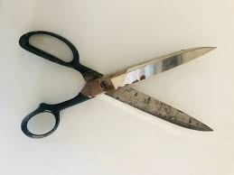

Slide 4
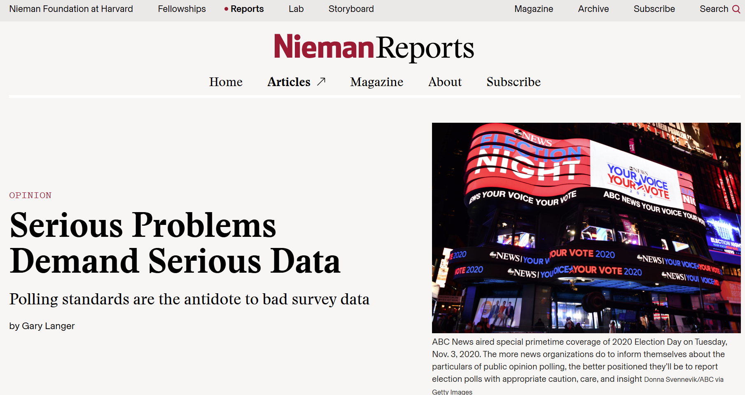
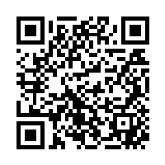
Fuller story here
https://niemanreports.org/elections-polling-data-standards/

Slide 5
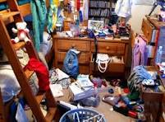

Slide 6
AAPOR Report on Online Panels
https://aapor.org/wp-content/uploads/2022/11/nfq048.pdf
“Researchers should avoid nonprobability online panels when one of the research objectives is to accurately estimate population values.”
“The nonprobability character of volunteer online panels… violates the underlying principles of probability theory.”
“There currently is no generally accepted theoretical basis from which to claim that survey results using samples from nonprobability online panels are projectable to the general population. Thus, claims of ‘representativeness’ should be avoided when using these sample sources.”
“Empirical evaluations of online panels abroad and in the U.S. leave no doubt that those who choose to join online panels differ in important and nonignorable ways from those who do not.”
“The reporting of a margin of sampling error associated with an opt-in or self-identified sample is misleading.”

Slide 7
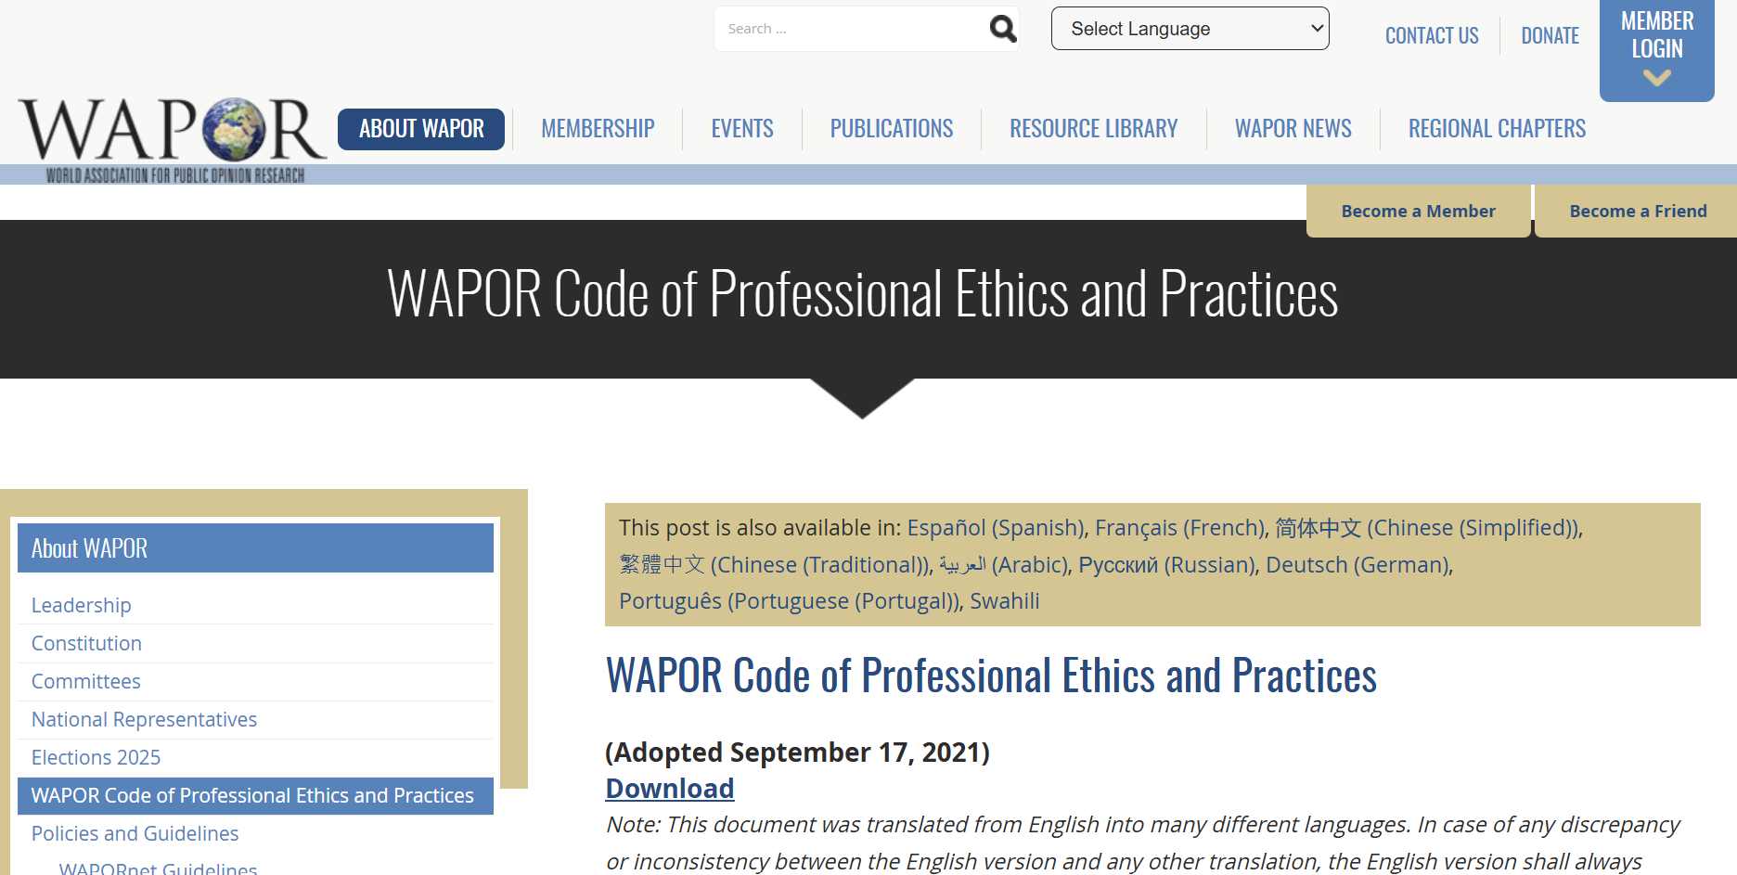
Assessment relies on disclosure

Slide 8
C. Rules of Practice Regarding Reports and Study Results
1. Every report on a study shall contain a complete and accurate description of the following relevant points:
(a) The Clients/Sponsors for whom the study was conducted and sources of funding, if different.
(b) The Data Collector(s) which conducted the study, and the names of the Data Processor(s) and the Party or Parties supplying the sample(s), if applicable.
(c) The purpose of the study.
(d) The universe or population to which the results of the study are projected.
(e) The method by which the sample was selected and/or recruited, including the type of sampling method (probability, quota, panels, river sampling, etc.), the specific procedures by which it was selected and the actual size of the sample, including descriptions of the recruitment and maintenance of panels.
(f) The degree of success in building the sampling frame and carrying out the sample design, including the rate of non-response, how it was calculated, and a comparison of the size and characteristics of the actual and anticipated sample.
(g) A description of estimating procedures (if any) and/or weighting procedures used to adjust raw data.
(h) The dates, mode(s) and methods of data collection. The total sample size and size of sub-groups if results are separately reported.
(i) An e-copy of the full questionnaire in all languages used in field, including instructions to the field team.
(j) Which results are based on parts of the sample (for example by filtering), rather than the whole sample.
(k) Researcher shall also report any limitations in survey coverage of the target population(s) resulting from a variety of causes including, but not limited to, geography, local conditions, force majeure events, weather, inaccessible buildings, political violence, public health issues, limitations of data collected from social media platforms (such as but not limited to scraping Twitter), and governmental restrictions on opinion surveys.
(l) Measures of sampling precision shall be clearly defined and presented.
(m) Researchers shall provide a description of the precision of the findings including, but not limited to, estimates of sampling error, design effects, calculation of weights, and the impact of (complex) weighting on survey findings.

Slide 9
The News from Gallup International
10/25/24
President Kamala Harris to bring global stability and improve America’s standing in the world
“Sample Size and Mode of Field Work:
“A total of 40.888 persons in 43 countries were interviewed globally. In each country a representative sample of around 1000 men and women was interviewed during October 2024 either face to face, via telephone or online. The margin of error for the survey is between +3-5% at 95% confidence level.”
Unreported: Probability-based samples in 15 countries (Sweden, Mexico, Georgia, Iran, Pakistan, Syria, Lebanon, Iraq, Korea, Russian Federation, Norway, Finland, Estonia, Latvia, Lithuania)
Nonprobability samples in 28 countries.

Slide 10
Let’s be clear
GIA: “In each country a representative sample…”
AAPOR: “…claims of ‘representativeness’ should be avoided when using these sample sources.”
GIA: “The margin of error for the survey is between +3-5% at 95% confidence level.”
AAPOR: “The reporting of a margin of sampling error associated with an opt-in or self-identified sample is misleading.”

Slide 11
An endorsement
10/27/24
Torbjörn Sjöström
Gallup International have together with its members. My company Novus being one of the, conducted a survey on the view on the presidential election if they support Harris or Trump and also the view on US and the effects on the outcome of the election.
Novus have also created a dashboard where you can explore the results yourself.
Read more on this page and below.
Novus / Gallup International - Harris vs Trump

Slide 12
Nothing New
07/24/2025
Two Decades of Change: Global Religiosity Declines While Atheism Rises
“In each country a representative sample of around 1000 men and women was interviewed … The margin of error for most country level surveys is between ±3 – 5 % at 95 % confidence level.”
06/24/25
Majority Worldwide Say Child’s Gender Does Not Matter – Yet Regional and Social Divides Persist
“In each country a representative sample of around 1000 men and women was interviewed … The margin of error for most country level surveys is between ±3 — 5 % at 95 % confidence level.”
05/16/2025
Bridging Gaps: Mobile Technology's Impact on Quality of Life
In each country a representative sample of around 1000 men and women was interviewed … The margin of error for most country level surveys is between ±3 – 5 % at 95 % confidence level.”

Slide 13
Plenty of company
WAPOR Webinar on September 10: The 2025-2026 Global Digital Wellbeing Survey
King Abdulaziz Center for World Culture (Ithra), commissioned PSB Insights Middle East, a wholly owned subsidiary of ASDA’A BCW, to conduct a comprehensive global research study with the general public to explore the role and impact of technology on their daily lives. The research was carried out between 12th June and 11th July 2021 with N=15,000 members of the general public. In each of the 30 countries included, N=500 interviews were conducted with a representative sample of people from different genders and generations. The survey’s margin of error is +/- 0.7 per cent globally and larger for subgroups.

Slide 14
Next up from WAPOR
9/9/25
Colin Irwin
“Dear WAPOR Members
“…we have formed a Special Committee, the ‘Global Report on Important Topics’ (GRIT) Committee with the mandate to invite members to participate in a global study, with a new topic each year, of relevance to the UN SDGs.
“…Please find attached a copy of the questions that we hope you will be able to run ‘pro bono’ in one of your omnibus surveys.”
As to the niceties of survey sampling… not a word.

Slide 15
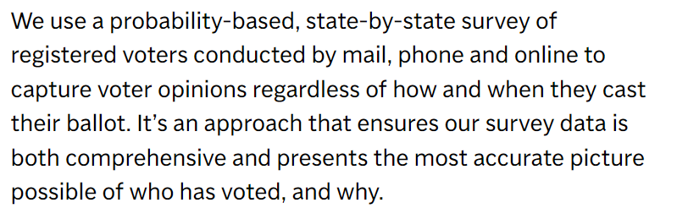
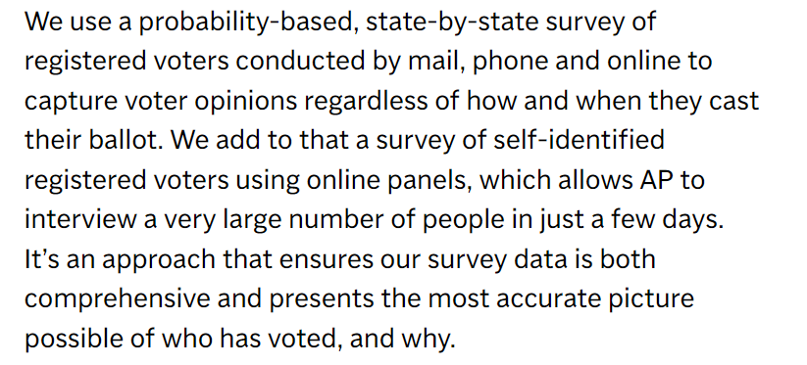
Et tu, AP?
Associated Press VoteCast: The margin of sampling error for voters is estimated to be plus or minus 0.4 percentage points. https://apnews.com/projects/election-results-2024/votecast/
AP used to say:
Oops. AP now says:

Slide 16
AP’s fieldwork provider says:
“AP VoteCast takes interviews with a random sample of registered voters drawn from state voter files and combines them with interviews from self-identified registered voters selected using nonprobability approaches.”
https://www.norc.org/content/dam/norc-org/pdfs/VoteCastMethodologyStatement%202022%20GE_10252022.pdf

Slide 17


Slide 18
All the kids do it
“…CHIP50 survey participants are recruited by 22 vendors who use a variety of strategies and incentives to maintain online respondent panels.”
“Inferences. In making inferences from data, statistical significance tests and confidence intervals with nonprobability samples are technically inappropriate. Yet, CHIP50 follows the common practice in using these approaches…”
https://www.chip50.org/survey-methodology

Slide 19

Let’s talk
At LRA, when we go there (admittedly rarely), we say: Results are not reliably representative within a calculable margin of sampling error.
This reflects my understanding of the principles of inferential statistics.
If yours are different, here’s an easy ask:
Fully disclose what you’re doing.
Justify your research claims.
Open your work to independent validation.

Slide 20
To be sure, the media still will blow it
The Economist: “The Anti-Defamation League, an advocacy group in America, says that 83% of Jewish students there have experienced antisemitism on campus since the war began.”
https://www.economist.com/middle-east-and-africa/2025/03/27/the-war-in-gaza-has-unsettled-the-jewish-diaspora

Slide 21
The Economist: “83% of Jewish students”
Methodology: “Panel members are recruited by a number of methods to help ensure student diversity in the panel population, including web advertising, permission-based email campaigns, and partnerships with university-affiliated organizations.”
https://collegepulse.com/methodology/
ADL: “Though this sample is not nationally representative, the distribution of both Jewish and non-Jewish college students across key demographics ensures a wide range of diverse opinions and experiences could be captured.”
https://www.adl.org/resources/report/campus-antisemitism-one-year-after-hamas-terrorist-attacks

Slide 22
The Economist: “…experienced antisemitism on campus”
ADL: “83.2% of Jewish college students surveyed have experienced or witnessed some form of antisemitism since the October 2023 Hamas attacks on Israel.”
… 83.2% “said they had witnessed, experienced, or seen an example of at least one antisemitic incident on campus…
https://www.adl.org/resources/report/campus-antisemitism-one-year-after-hamas-terrorist-attacks

Slide 23
The Economist: “…antisemitism on campus”
Apparently no questionnaire released, however see: ADL-Gratz Model Campus Climate Survey Instrument - “a tool for college and university stakeholders to assess the experiences of antisemitism among Jewish students”
https://www.adl.org/sites/default/files/documents/2024-11/adl-gratz-model-campus-climate-survey-instrument-v2.pdf
5. Have any of the following occurred on [UNIVERSITY] campus since you have been a student? Select all that apply.
c. Posting of a flyer, banner, or sign on campus about ISRAEL that you found to be problematic or made you uncomfortable
e. Anti-Israel encampment
f. Anti-Israel protest, rally or demonstration
g. Disruptions to commencement ceremony (e.g., delays, being remote instead of in-person, speaker interruptions, etc.) due to anti-Israel protest
6. Please select any of the following experiences that you have witnessed since you have been a student at [UNIVERSITY]. Select all that apply.
c. Someone made comments about ISRAEL that you viewed as problematic or made you uncomfortable e. A group of students protested or interrupted an ISRAELI or pro-ISRAELI speaker, event, or other activity
g. You saw a post from a student, professor, or someone else associated with the university about ISRAEL on social media or somewhere else online that you viewed as problematic or made you uncomfortable
7. Since you have been a student at [UNIVERSITY], have you experienced any of the following based on your real or perceived Jewishness or support of Israel? Select all that apply.
b. In a conversation with you, someone made offensive or derogatory anti-ISRAEL remarks
d. Someone sent or posted offensive anti-ISRAEL content online or on social media to or about you

Slide 24
What’s to be done?
Reporters need to report
News organizations need to establish poll reporting standards, informing both the public and their own reporters and editors
But before all that:
Poll producers and sponsors need to provide full, honest disclosure
Make factually supportable claims about our research
And cut the B.S.

Slide 25
Thank you!
Gallup International Association • Sept. 23, 2025
Gary Langer
Langer Research Associates
glanger@langerresearch.com

