Slide 1
Media reporting of polls …and how to improve it
NEAAPOR • April 7, 2025
Gary Langer
Langer Research Associates
glanger@langerresearch.com

Slide 2
My background - and the problem
10 years as an AP reporter
30+ years covering the beat of public opinion for ABC News
I know the drill:
Numbers and percentage signs lend credibility to anecdote
Reporters are both data hungry and math phobic
Too often, polling = P.R.

Slide 3
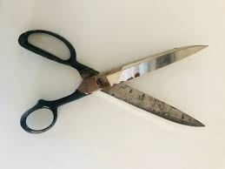

Slide 4
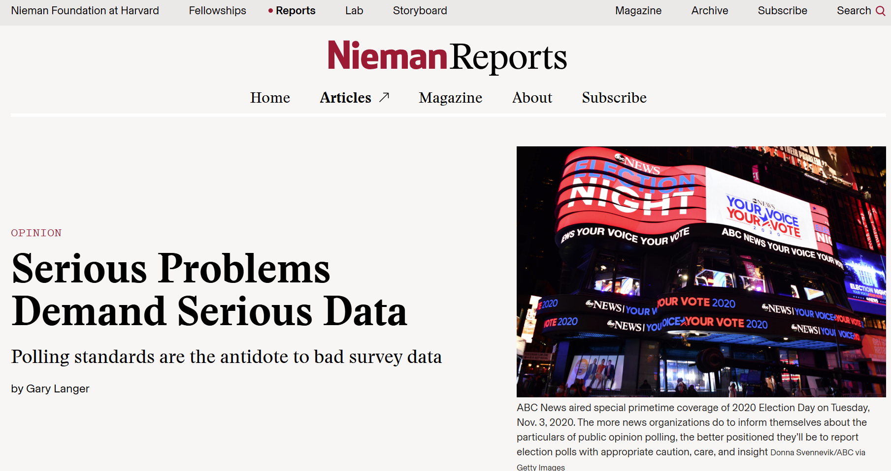
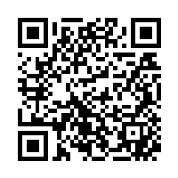
Fuller story here
https://niemanreports.org/elections-polling-data-standards/

Slide 5
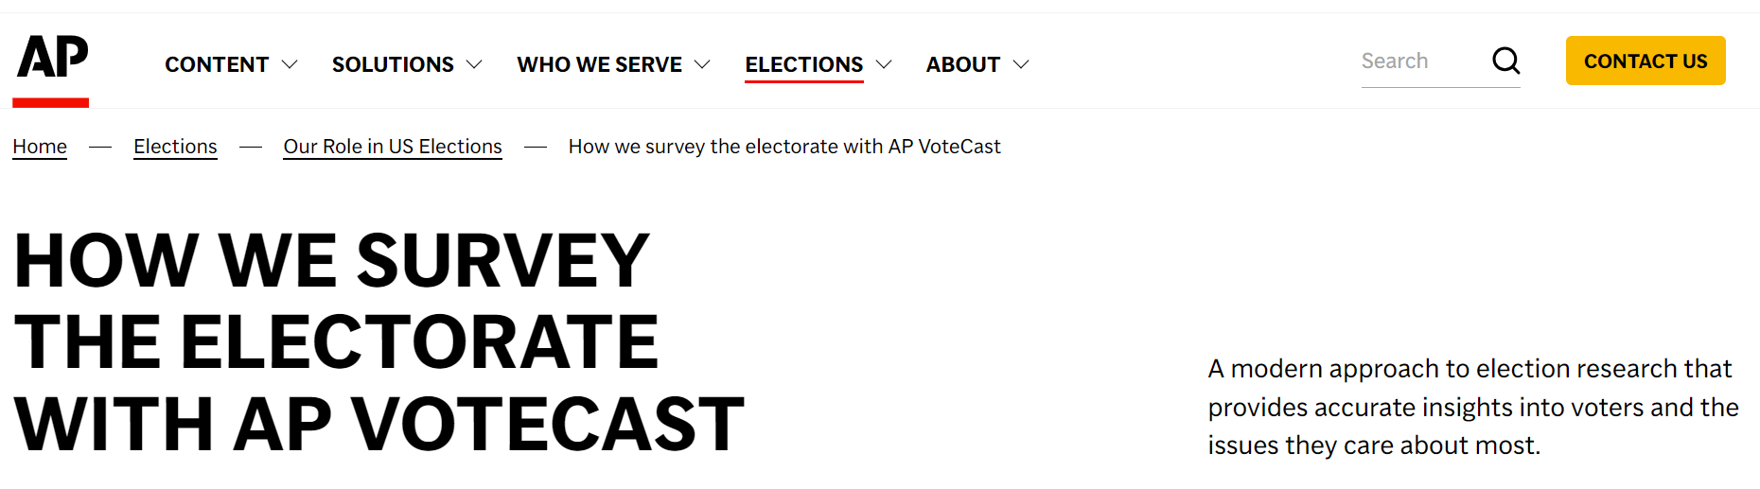
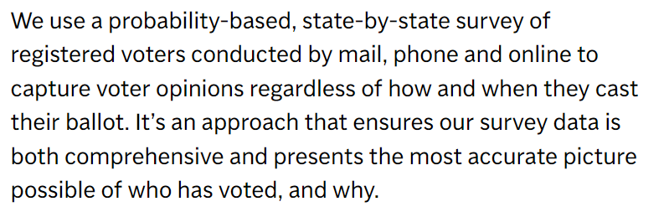

Slide 6
“AP VoteCast takes interviews with a random sample of registered voters drawn from state voter files and combines them with interviews from self-identified registered voters selected using nonprobability approaches.”
https://www.norc.org/content/dam/norc-org/pdfs/VoteCastMethodologyStatement%202022%20GE_10252022.pdf

Slide 7
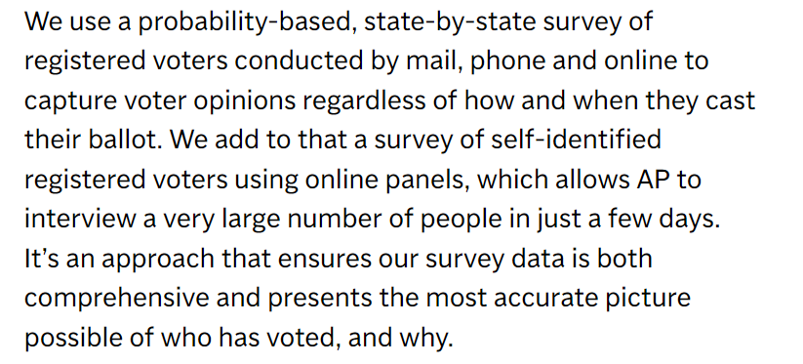
“AP VoteCast takes interviews with a random sample of registered voters drawn from state voter files and combines them with interviews from self-identified registered voters selected using nonprobability approaches.”
https://www.norc.org/content/dam/norc-org/pdfs/VoteCastMethodologyStatement%202022%20GE_10252022.pdf

Slide 8
AAPOR Report on Online Panels
https://aapor.org/wp-content/uploads/2022/11/nfq048.pdf
“Researchers should avoid nonprobability online panels when one of the research objectives is to accurately estimate population values.”
“The nonprobability character of volunteer online panels… violates the underlying principles of probability theory.”
“There currently is no generally accepted theoretical basis from which to claim that survey results using samples from nonprobability online panels are projectable to the general population. Thus, claims of ‘representativeness’ should be avoided when using these sample sources.”
“Empirical evaluations of online panels abroad and in the U.S. leave no doubt that those who choose to join online panels differ in important and nonignorable ways from those who do not.”
“The reporting of a margin of sampling error associated with an opt-in or self-identified sample is misleading.”

Slide 9
AP: The margin of sampling error for voters is estimated to be plus or minus 0.4 percentage points. Find more details about AP VoteCast’s methodology at https://ap.org/votecast.
https://apnews.com/projects/election-results-2024/votecast/
AAPOR: “The reporting of a margin of sampling error associated with an opt-in or self-identified sample is misleading.”
https://aapor.org/wp-content/uploads/2022/11/nfq048.pdf

Slide 10
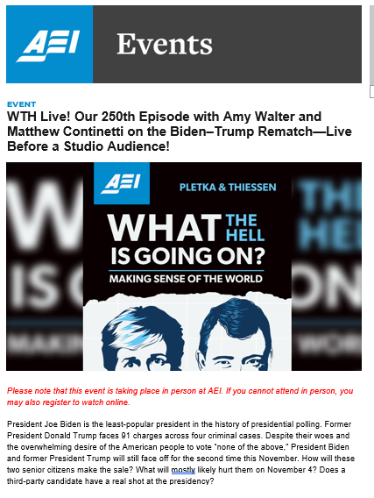
Distrust… and Verify
“President Joe Biden is the least-popular
president in the history of presidential polling.”
Let’s check… Gallup data:
Biden at the time | 40%
Biden low | 37%
Truman | 24%
Nixon | 24%
Bush 43 | 25%
Carter | 28%
Bush 41 | 33%
Trump 45 | 35%
Apparent Source:
“Biden’s 13^{th-}Quarter Approval Average Lowest Historically”
https://news.gallup.com/poll/644252/biden-13th-quarter-approval-average-lowest-historically.aspx

Slide 11
A (Very) Recent Example:
The Economist, March 27, 2025
“The Anti-Defamation League, an advocacy group in America, says that 83% of Jewish students there have experienced antisemitism on campus since the war began.”
https://www.economist.com/middle-east-and-africa/2025/03/27/the-war-in-gaza-has-unsettled-the-jewish-diaspora

Slide 12
The Economist: “83% of Jewish students”
Methodology: “Panel members are recruited by a number of methods to help ensure student diversity in the panel population, including web advertising, permission-based email campaigns, and partnerships with university-affiliated organizations.”
https://collegepulse.com/methodology/
ADL: “Though this sample is not nationally representative, the distribution of both Jewish and non-Jewish college students across key demographics ensures a wide range of diverse opinions and experiences could be captured.”
https://www.adl.org/resources/report/campus-antisemitism-one-year-after-hamas-terrorist-attacks

Slide 13
The Economist: “…experienced antisemitism on campus”
ADL: “83.2% of Jewish college students surveyed have experienced or witnessed some form of antisemitism since the October 2023 Hamas attacks on Israel.”
… 83.2% “said they had witnessed, experienced, or seen an example of at least one antisemitic incident on campus…
https://www.adl.org/resources/report/campus-antisemitism-one-year-after-hamas-terrorist-attacks

Slide 14
The Economist: “…antisemitism on campus”
Apparently no questionnaire released, however see: ADL-Gratz Model Campus Climate Survey Instrument - “a tool for college and university stakeholders to assess the experiences of antisemitism among Jewish students”
https://www.adl.org/sites/default/files/documents/2024-11/adl-gratz-model-campus-climate-survey-instrument-v2.pdf
5. Have any of the following occurred on [UNIVERSITY] campus since you have been a student? Select all that apply.
c. Posting of a flyer, banner, or sign on campus about ISRAEL that you found to be problematic or made you uncomfortable
e. Anti-Israel encampment
f. Anti-Israel protest, rally or demonstration
g. Disruptions to commencement ceremony (e.g., delays, being remote instead of in-person, speaker interruptions, etc.) due to anti-Israel protest
6. Please select any of the following experiences that you have witnessed since you have been a student at [UNIVERSITY]. Select all that apply.
c. Someone made comments about ISRAEL that you viewed as problematic or made you uncomfortable e. A group of students protested or interrupted an ISRAELI or pro-ISRAELI speaker, event, or other activity
g. You saw a post from a student, professor, or someone else associated with the university about ISRAEL on social media or somewhere else online that you viewed as problematic or made you uncomfortable
7. Since you have been a student at [UNIVERSITY], have you experienced any of the following based on your real or perceived Jewishness or support of Israel? Select all that apply.
b. In a conversation with you, someone made offensive or derogatory anti-ISRAEL remarks
d. Someone sent or posted offensive anti-ISRAEL content online or on social media to or about you

Slide 15
What’s to be done?
Reporters need to report
News organizations need to establish poll reporting standards, informing both the public and their own reporters and editors
Poll producers and sponsors need to provide full, honest disclosure

Slide 16
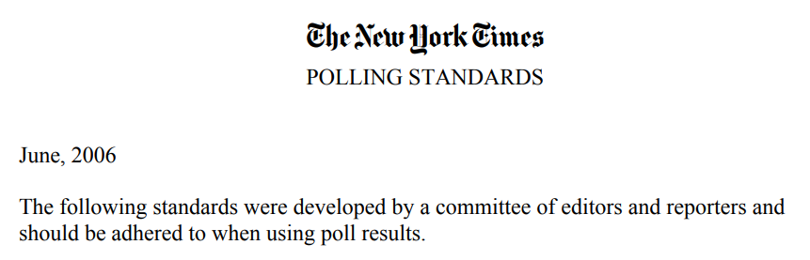
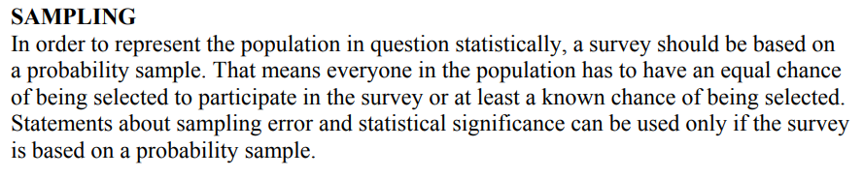
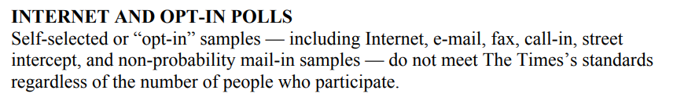
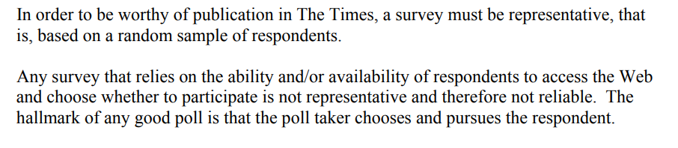
It used to happen.
It can again!

Slide 17
Thank you!
NEAAPOR • April 7, 2025
Gary Langer
Langer Research Associates
glanger@langerresearch.com

