Slide 1
Bloomberg Consumer Comfort Index:
Concurrent and Predictive Validity
NYAAPOR April 7, 2011
Gary Langer
Langer Research Associates
glanger@langerresearch.com

Slide 2
Bloomberg CCI Overview
Weekly since 12/85 (previously ABC News)
4-week rolling average of 1,000 RDD interviews
Current sentiment (excellent, good, not so good, poor)
  National economy
  Personal finances
  Buying climate
  Cronbach’s α = .85 (good internal consistency)
Economic expectations (better, worse same)
  measured separately, monthly

Slide 3
Notes:
Starts dropping prior to recessions – takes a long time to dig out of recessions

Slide 5
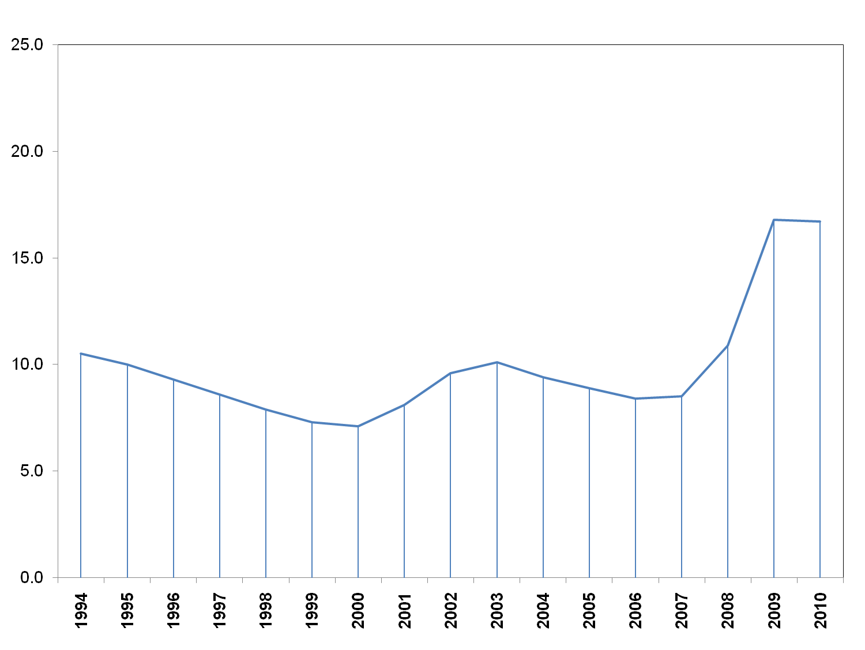
U-6 Rate
Percent unemployed or marginally attached
Bureau of Labor Statistics

Slide 6
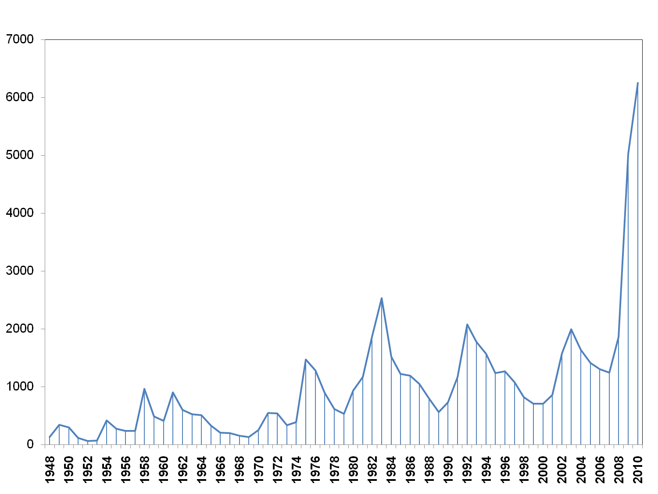
Long-term Unemployment
Number unemployed for 27 weeks or more, in thousands
Bureau of Labor Statistics

Slide 7
Percent change of constant-dollar median usual weekly earnings
1979-2009
Bureau of Labor Statistics
Less than a high school diploma
High school graduate
Some college or associate’s degree
Bachelor’s degree and higher
14%
31%
74%
of the US Population
29%
26%

Slide 8
Average: -1.1
Average: -20.9
Average: -40.5

Slide 9
Average: 14.1
Average: -51.3

Slide 10
Average: -36.7
Average: -56.5

Slide 11
Notes:
It is going up… but of course at this rate, it won’t return to it’s current long-term average (-14) for 566 weeks, or 10.9 years. And it won’t break into positive territory for 835 weeks or about 16 years.

Slide 12
Notes:
Unusually volatile.

Slide 13
Dueling Economic Forces
Positives
Negatives
Unemployment (8.8%), high but 2-yr low
Dow closed March at its highest since May ’08
Weekly unemployment insurance claims down
GDP steadily growing
Gasoline: $3.68, Feb-March-April records
Prices (esp. food and fuel) rising faster than wages
Housing market still tanking
Average length of unemployment at an all-time high

Slide 16
Other Major Confidence Indices
Reuters / University of Michigan
  Since 1946, monthly since ’76
  Current sentiment/expectations, combined
  n = 500 RDD; partial mid-month release, n = 250-300
Conference Board
  Since 1967, monthly since ’77
  Current sentiment / expectations, combined
  Recent switch from non-probability to probability sample

Slide 21
CCI and Economic Indicators
Tricky because many economic indicators have a strong time trend (especially $-based indicators):
 | Time
CPI | .99
GDP | .99
Hourly wages | .99
Personal expenditures | .99
Revolving credit | .99
Dow | .92
Gas prices | .84

Slide 22
Detrending for Time
Regression with time predicting economic variable:
  EconIndicator = X(time) + e
  e = variation in the economic indicator that isn’t directly a function of time
  Tells you whether the economic indicator is higher or lower (and how much) than would be expected based solely on time.
Correlate the residual (e) with the CCI
  Contemporaneously
  Also on a time-lagged basis

Slide 37
That ain’t all

Slide 40
Take-aways
More work to do!
  Correlate individual subindices w/ other indicators
    Econ index + GDP; Finances + DJIA, income, consumer credit; Buying climate + retail sales, etc.
  Correlate individual groups w/ other indicators
    $100K + S&P luxury goods index, DJIA, CPI; homeowners + housing prices, etc.
  Add additional indicators
    Home sales, housing starts, home prices
    Personal savings rate, durable goods orders, industrial production, construction spending, inventory/sales ratio
  Given lagged corrs, explore predictive modeling

Slide 41
Thank You!
NYAAPOR April 7, 2011
Gary Langer
Langer Research Associates
glanger@langerresearch.com

